Slide 1

CSE445.3 - MSRb
01
Facial Expression Recognition using CNN Architectures
Presented by Group 5
Tanzeem Haque - 2131122642
S M Samiul Haq - 2011103042
Entiser Hossain - 2021789642
Tofayel Ahmed - 2112096042

Slide 2
CSE445.3 - MSRb
02
Abstract / Overview
Developed a CNN-based system to classify facial expressions (Angry, Happy, Neutral, Surprised).
Leveraged ResNet50 for optimal balance of efficiency and accuracy.

Slide 3

CSE445.3 - MSRb
03
Introduction
Enhancing human-computer interaction by interpreting facial expressions.
Real-world impact: Applications in accessibility, assistive technologies, and psychology.
Broad applications: Potential use in security systems, entertainment (e.g., gaming), and customer service automation.
www.reallygreatsite.com

Slide 4
CSE445.3 - MSRb
04
Literature Review
Deep residual learning (ResNet50) for facial expression recognition.
Challenges in emotion recognition (Goodfellow et al.).
VGG-Face vs. ResNet50 for computational feasibility.

Slide 5
CSE445.3 - MSRb
05
Objective
DATASET
Create an robust dataset of different products
MODEL
Train models for identifying different products
BUILD THE SYSTEM
Build a vision-based system that detects and identifies facial expressionfrom a single image.

Slide 6
CSE445.3 - MSRb
06
DATASET

Slide 7
CSE445.3 - MSRb
07
Importance of Data
•Foundation of Model Accuracy
•Adapts to Real-World Conditions
•Enable Proper Training and Testing

Slide 8
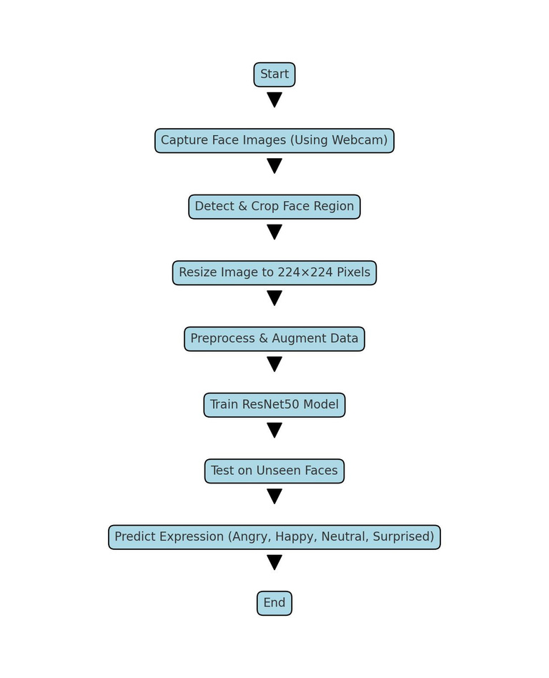
CSE445.3 - MSRb
08
Data preparation process

Slide 9

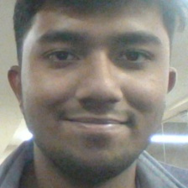

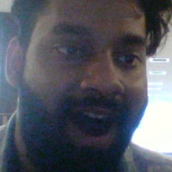
CSE445.3 - MSRb
09
Capturing Images in Various Face
Source: 12 individuals
Classes: Angry, Happy, Neutral, Surprised
Images: 100 per class/person → 4,000 total
Split: 10 for training, 2 for testing (800 images)
“Sad” class removed (too similar to Neutral)
Angry
Happy
Surprised
Neutral

Slide 10
CSE445.3 - MSRb
10
Dataset Collection Using Webcam
Starts webcam using OpenCV
Detects faces using FaceDetector from CVZone
Crops the face area with a small margin (offset)
Resizes cropped image to 224x224 pixels (standard size for training)
Press ‘s’ to start saving images
Press ‘f’ to stop saving
Images are saved in a selected folder with unique timestamped filenames
Press ESC to exit the program

Slide 11
CSE445.3 - MSRb
11
Why Python and OpenCV?
Easy to Learn and Use
Powerful Image Processing with OpenCV
Real-Time Face Detection
Free and Open-Source

Slide 12
CSE445.3 - MSRb
12
MODEL

Slide 13
CSE445.3 - MSRb
13
Model Architecture
Base Model: Pre-trained ResNet50 (ImageNet weights)
Modifications:
Input Size: 224 × 224
Data Augmentation: Random flipping, rotation, zoom, brightness, and contrast adjustments
Custom Layers: Global Average Pooling → Dense (Softmax) for 4 classes
Fine-Tuning Strategy:
Initially freeze most layers
Unfreeze only the last 50 layers for improved adaptability

Slide 14
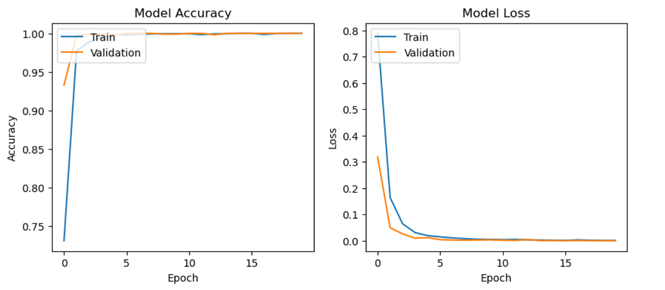
CSE445.3 - MSRb
14
Experimental Results

Slide 15
CSE445.3 - MSRb
15
Experimental Results
Iteration Summaries:
Iteration 1: All layers frozen; Accuracy ≈ 68%
Iteration 2: Unfreeze last 50 layers; Accuracy ≈ 76%
Iteration 3: All layers unfrozen; Accuracy dropped to ≈ 51%
Observations:
Gradual unfreezing improved performance
Over-unfreezing led to overfitting and class bias (e.g., consistent misclassification as “Surprised”)

Slide 16
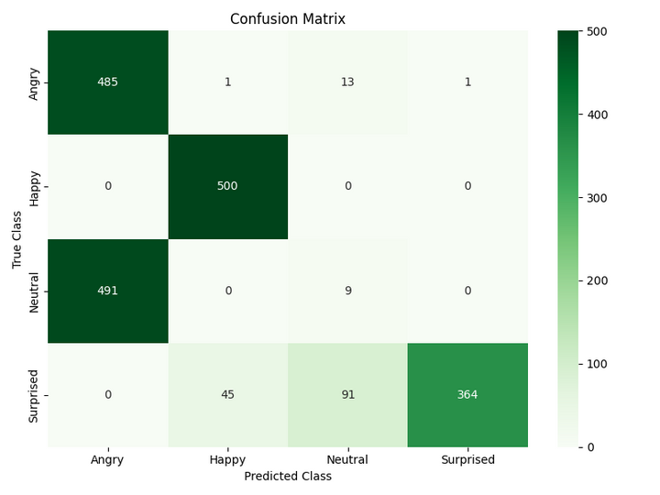
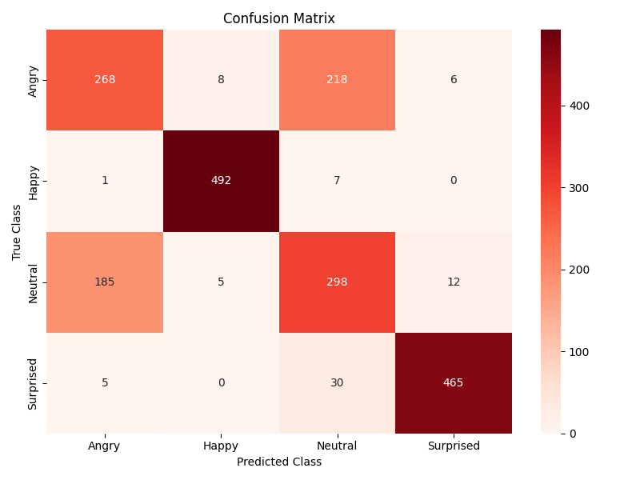
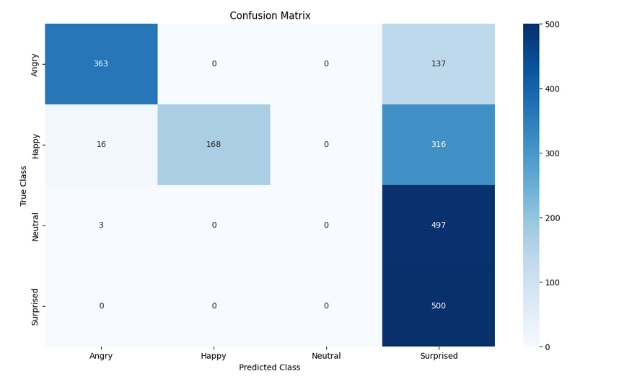
CSE445.3 - MSRb
16
Experimental Results
Figure 1: Confusion Matrix after 1st iteration
Figure 2: Confusion Matrix after 2nd iteration
Figure 3: Confusion Matrix after 3rd iteration

Slide 17
CSE445.3 - MSRb
09
Conclusion
Successfully developed a system to detect Angry, Happy, Neutral, and Surprised emotions from facial images.
Achieved 76% accuracy with partial fine-tuning of ResNet50.
Overfitting observed when all layers were unfrozen, reducing accuracy to 51%.
Best results for Happy and Neutral; Angry and Surprised were harder to classify.
Data augmentation played a key role in improving performance.
Tools used: Python, OpenCV, TensorFlow, Keras, Google Colab.
www.reallygreatsite.com

Slide 18
CSE445.3 - MSRb
09
Limitations
Dataset limited to 12 volunteers, all recorded in controlled indoor conditions
Only 4 emotions included: Angry, Happy, Neutral, Surprised
Sad, Fear, Disgust were excluded
Overfitting occurred when all layers of the model were trained
No real-time or dynamic testing was conducted
Training relied on Google Colab, requiring internet and GPU access
Evaluation metrics limited to accuracy and confusion matrix
No use of precision, recall, or F1-score
www.reallygreatsite.com

Slide 19
CSE445.3 - MSRb
09
Future Improvements
Expand dataset with greater diversity:
Include variations in age, gender, lighting conditions, and facial accessories (e.g., glasses, masks)
Add more emotion classes:
Include Sad, Fear, and Disgust for more comprehensive emotion recognition
Implement real-time detection:
Use OpenCV with threading to enable live emotion detection from webcam/video feed
Explore lighter models:
Test EfficientNet, MobileNet, and other optimized architectures for better performance
on edge devices
www.reallygreatsite.com

Slide 20
CSE445.3 - MSRb
10
Thank you!
www.reallygreatsite.com

